Slide 1
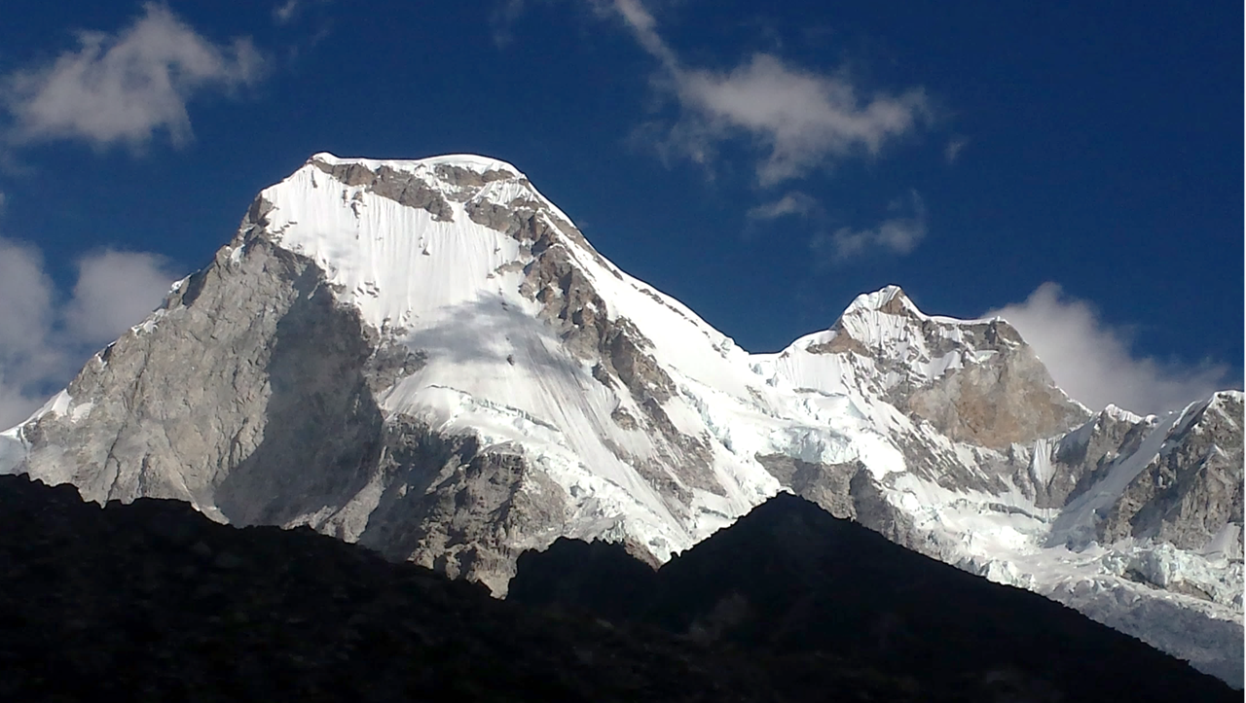
Paleoclimatic reconstruction during the Little Ice Age in the Llanganuco basin, Cordillera Blanca (Peru)
Joshua Iparraguirre¹, Jose Úbeda², Ronald Concha¹, Ramón Pellitero³, Javier de Marcos², Luzmila Dávila¹, Pool Vásquez⁴, Jesús Gómez¹ & Julia Araujo¹
¹Instituto Nacional de Investigación en Glaciares y Ecosistemas de Montaña (INAIGEM)
²Universidad Complutense de Madrid (UCM)
³Universidad de Educación a Distancia (UNED)
⁴Instituto Geológico, Minero y Metalúrgico (INGEMMET)

Slide 2
01
01
Step one
Development of a detailed geomorphogical map
Delimitation of palaeoglaciers and current glacial extension
Step one
Development of a detailed geomorphogical map
Delimitation of palaeoglaciers and current glacial extension
02
02
Step two
Glaciar bedrock Reconstruction – GLABTOP
Step two
Glaciar bedrock Reconstruction – GLABTOP
03
03
Step three
3D reconstruction of palaeoglaciers surface
Step three
3D reconstruction of palaeoglaciers surface
04
04
Step four
Calculation of Balance Ratio in a reference glacier
Step four
Calculation of Balance Ratio in a reference glacier
05
05
Step five
Automatic Equilibrium Line Altitud (ELA) reconstruction of glaciers and palaeoglaciers
Step five
Automatic Equilibrium Line Altitud (ELA) reconstruction of glaciers and palaeoglaciers
06
06
Step six
Estimation of palaeotemperature during LIA
Step six
Estimation of palaeotemperature during LIA

Slide 3
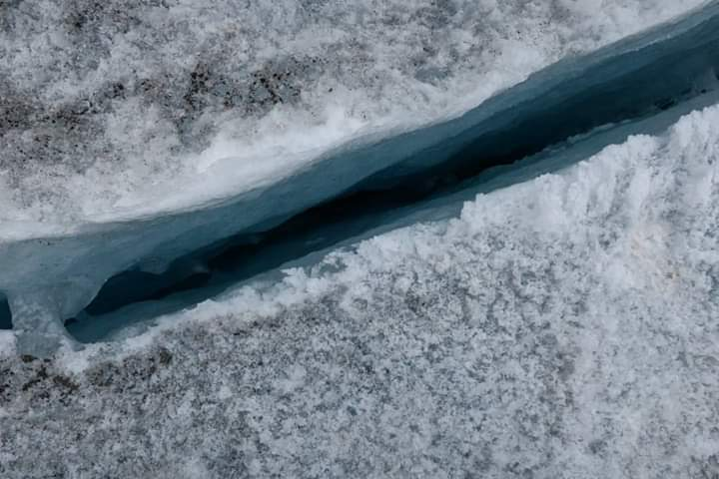
Step one Development of a detailed geomorphogical map Delimitation of palaeoglaciers and current glacial extension

Slide 4
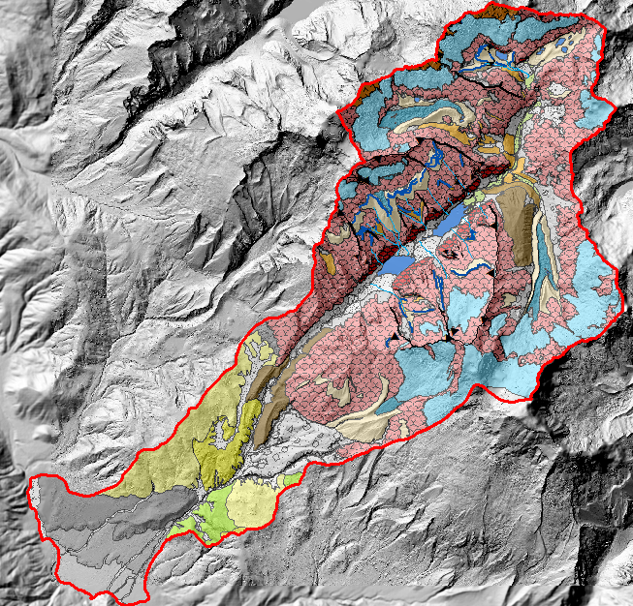
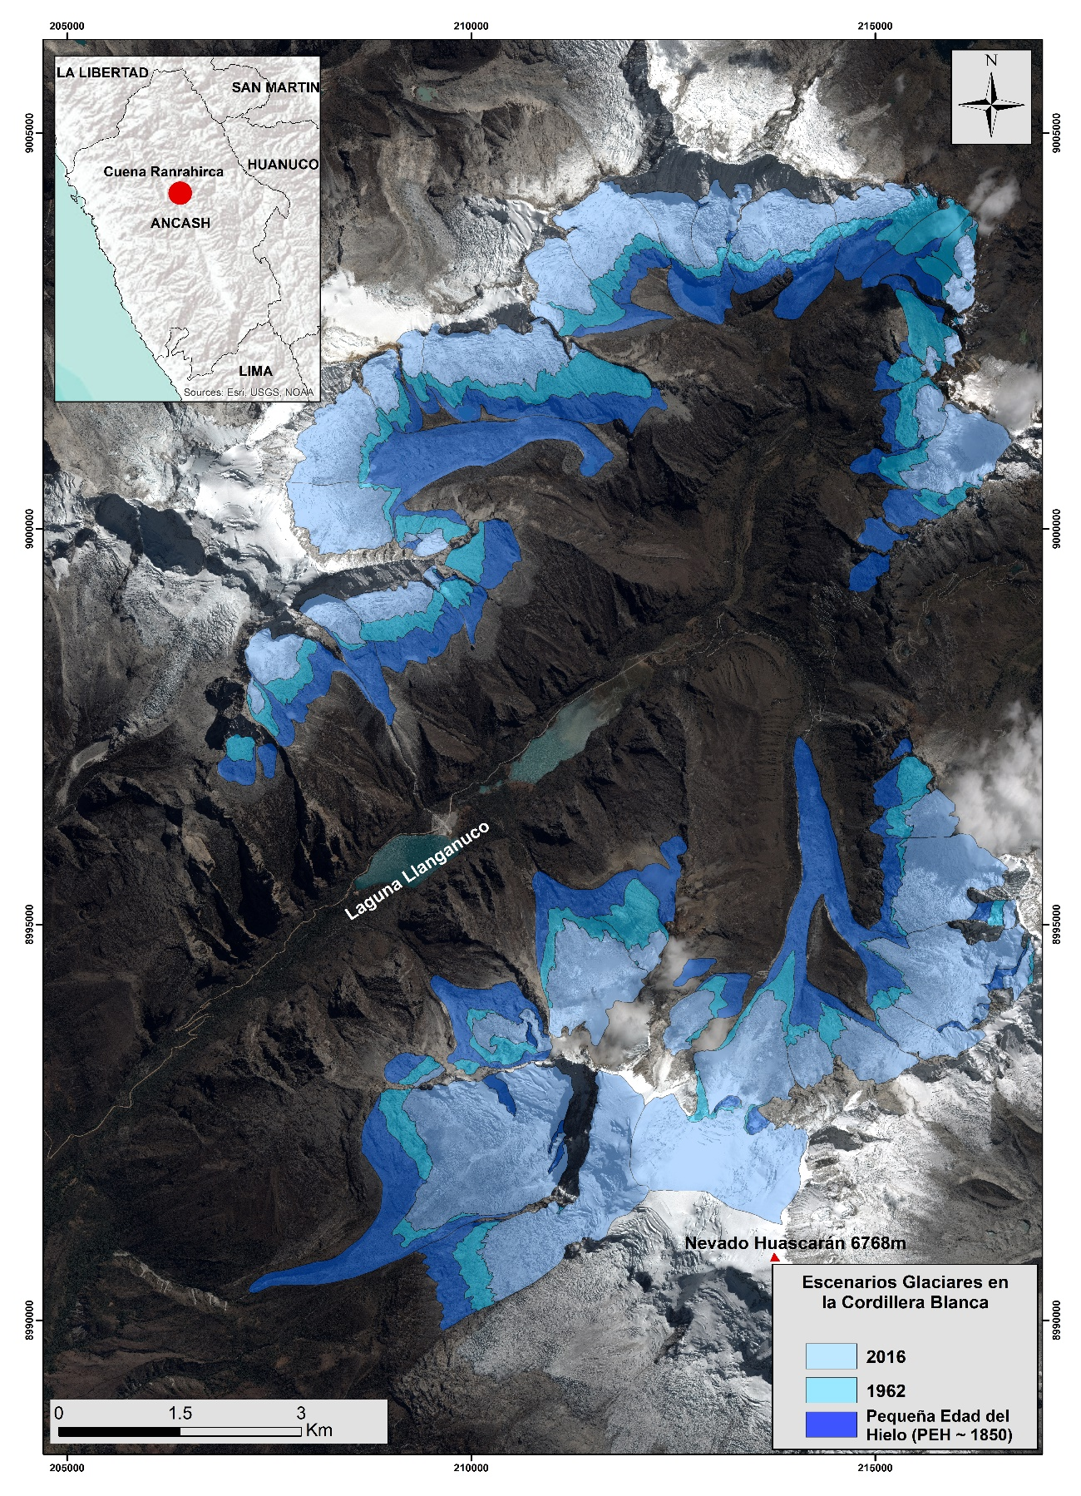
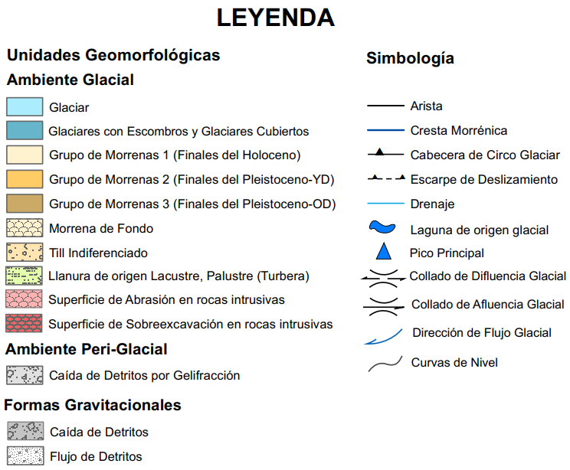

Slide 5
Step two Glaciar bedrock Reconstruction – GLABTOP Step three 3D reconstruction of palaeoglaciers surface

Slide 6
GLACIER BED TOPOGRAPHY

Slide 7
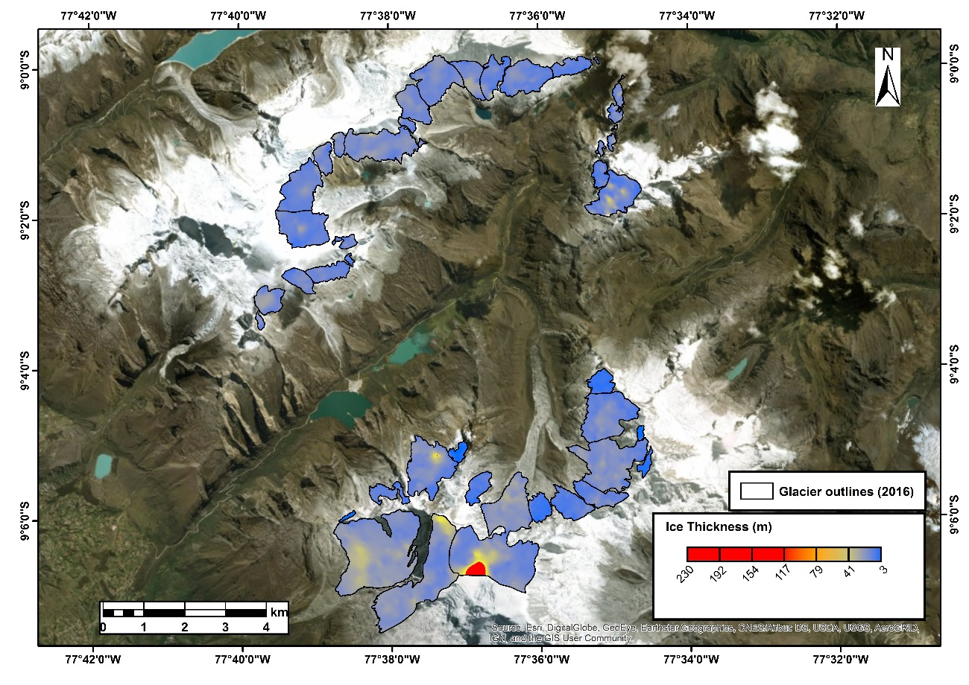

Slide 8
GLACIER RECONSTRUCTION (GLARE)

Slide 9
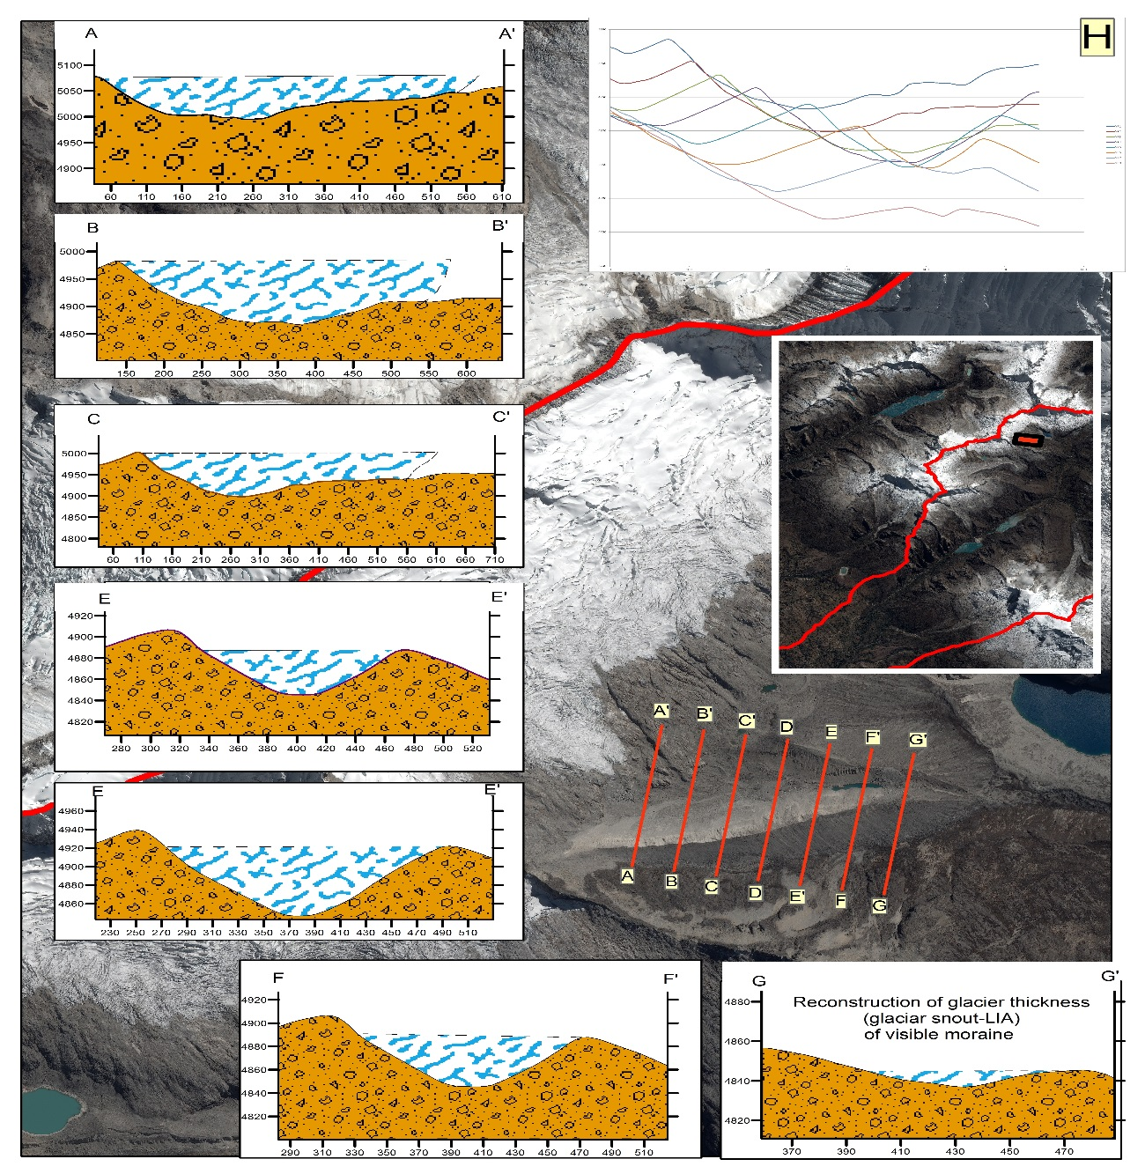
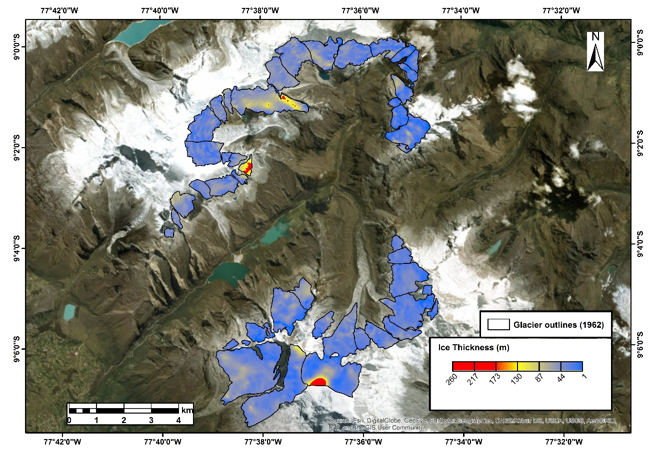
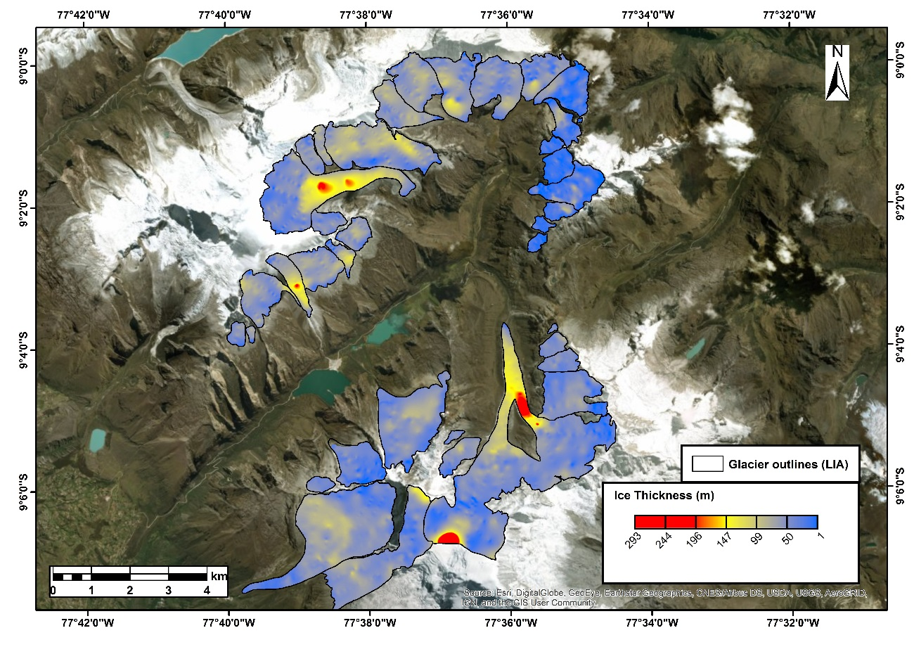

Slide 11
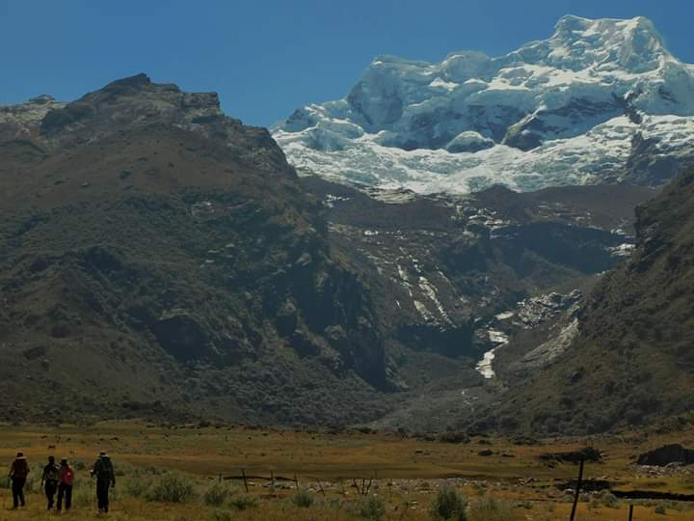
Step four Calculation of Balance Ratio in a reference glacier

Slide 12
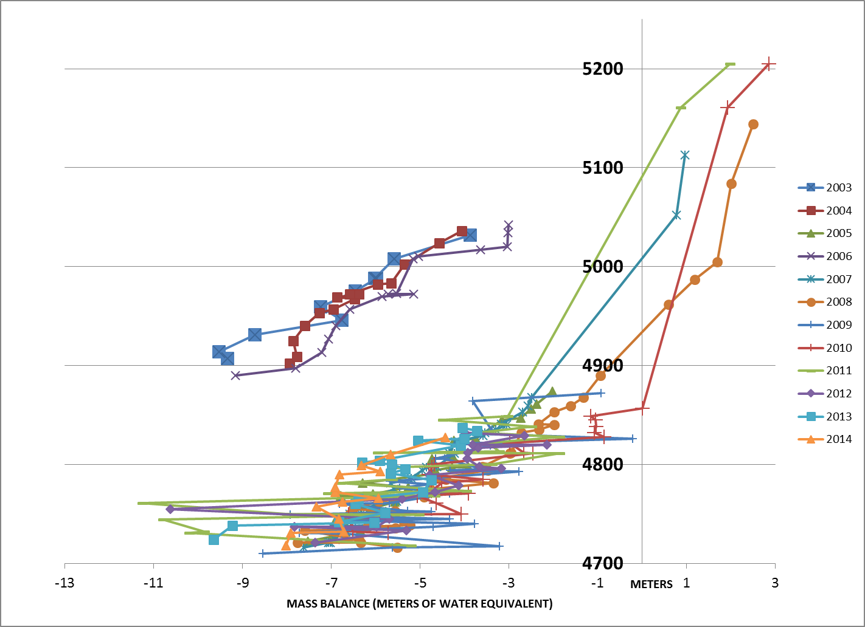
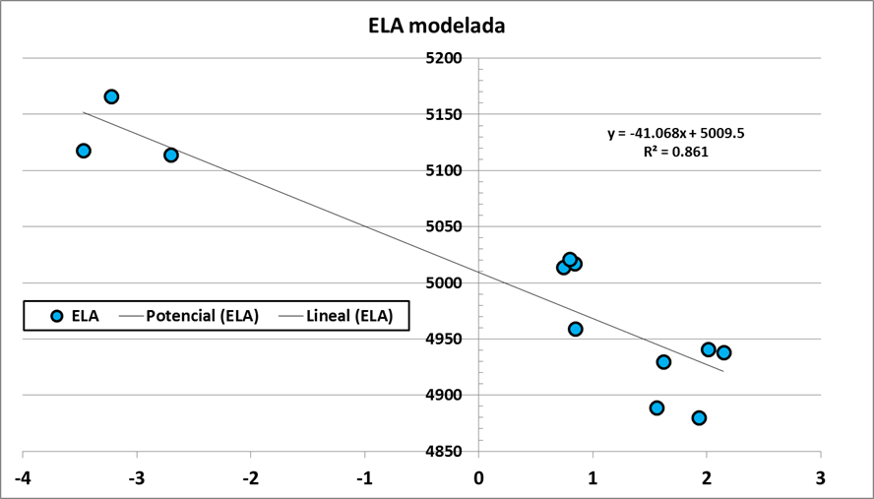
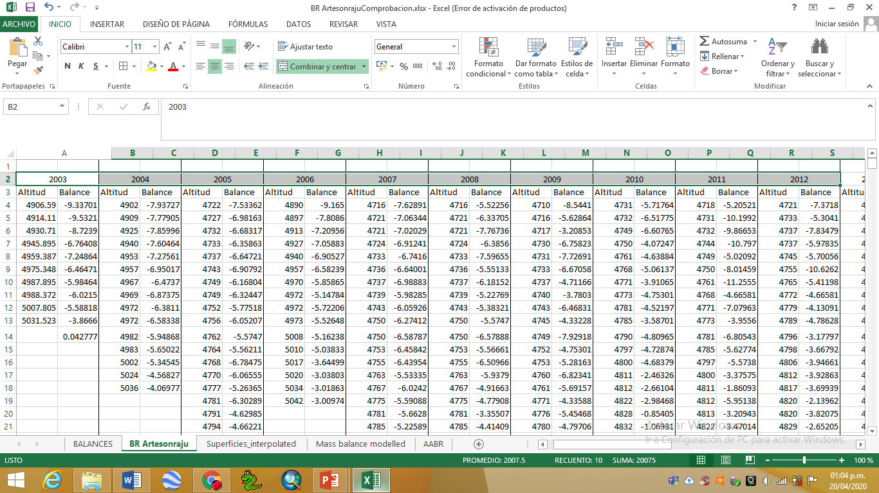

Slide 13
Step five Automatic Equilibrium Line Altitud (ELA) reconstruction of glaciers and palaeoglaciers

Slide 14
AABR
(Área x Altitud x Balance Ratio)
(Ahlmann, 1924, 1948, Loewe, 1971, Kotlyakov y Krenke, 1982, Braithwaite, 1985, 2008, Ohmura et al., 1992)

Slide 15
Step six Estimation of palaeotemperature during LIA

Slide 17
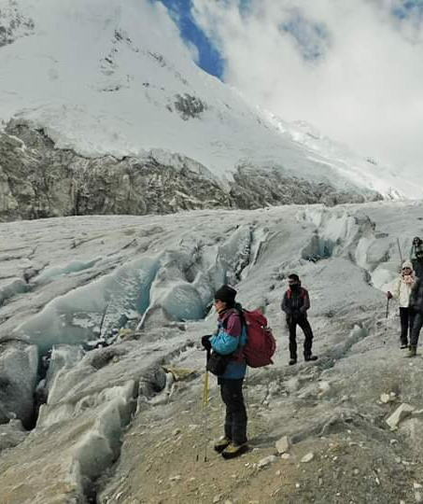
THANKS!
Does anyone have any questions?
iparraguirrea.joshua@gmail.com
+51 978 836 327

